Slide 1
Module 1

Slide 2

CONSTRUCTIONS
To construct equal angles
To divide line segment into given equal parts
Notes:
School
2

Slide 3
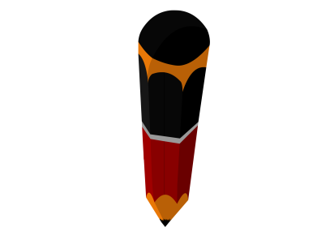
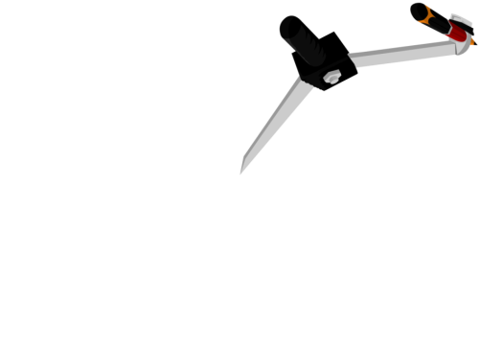

BASIC CONSTRUCTIONS
To construct an angle equal to the given angle.
X
P
A
A^{l}
×
1
2
3
4
5
6
7
8
9
10
11
12
13
14
15
×
Q
B
R
Y
1
2
B^{l}
Z
3
4
5
6
7
8
9
10
11
12
13
14
15
‘Q’ as centre and any suitable radius, draw an arc intersecting ray QP and QR at A and B respectively
Y as centre and same radius draw an arc intersecting ray YZ at B'
Now, Consider
Radius = AB,
Let us draw ∠XYZ equal to ∠PQR
Draw ray YZ
Consider ∠PQR
Join Y and A'
∠PQR = ∠XYZ
B ' as centre, cut the previous arc

Slide 4
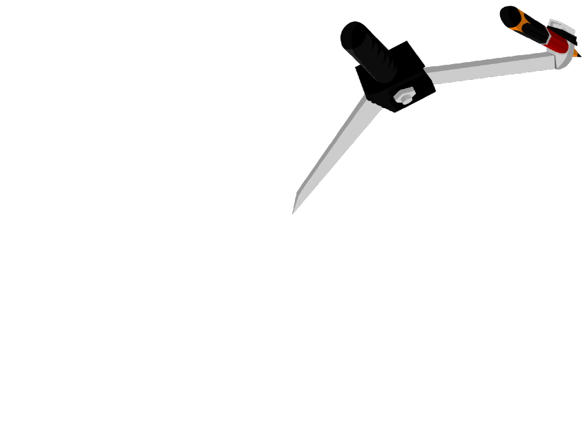
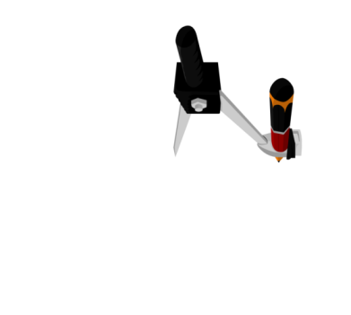
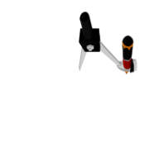

Q. Draw a line segment AB of length 6cm and divide it into
5 equal parts.
Considering any suitable radius, draw 5 arcs on ray AX
A₅ as centre, and any suitable radius draw an arc
Repeat same procedure at A₄, A₃, A₂ and A₁
Now consider Radius = PQ
Draw A₅B
Draw seg AB = 6cm
Draw ray AX
Draw A₄S intersecting AB at B₄
Draw A₃U intersecting AB at B₃
Draw A₁Z intersecting AB at B₁
Draw A₂W intersecting AB at B₂
T as centre cut an arc, and mark that point U
Y as centre cut an arc, and mark that point Z
R as centre cut an arc, and mark that point S
V as centre cut an arc, and mark that point W
Rough figure
B₁
B₂
B₃
B₄
A
B₁
B₂
B₃
B₄
B
A
Y
Z
6 cm
B
1
2
3
4
5
6
7
8
9
10
11
12
13
14
15
6 cm
A₁
W
V
A₂
U
T
A₃
S
R
A₄
Q
1
2
3
7
P
9
4
5
6
8
10
11
12
13
14
15
A₅
1
2
3
2
2
7
9
1
3
7
9
1
3
8
8
4
5
6
7
8
9
4
5
2
6
10
11
12
13
14
15
1
4
5
6
10
11
12
13
14
15
3
7
10
9
2
4
5
6
8
11
12
13
14
15
1
3
4
5
6
7
8
9
10
10
11
12
13
14
15
2
11
12
13
14
15
1
3
4
5
6
7
8
9
10
11
12
13
14
15
X

Slide 5
Module 2

Slide 6
CONSTRUCTIONS
To divide line segment into given ratio
Notes:
School
6

Slide 7
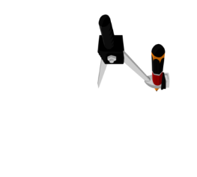


Ex-13.1 (Q.1)
Q. Draw a line segment of length 7.6cm and divide it in the ratio 5:8,
Measure the two parts.
AC : CB = 5:8
7.6 cm
A
C
B
C
7.6 cm
A
S
B
Rough Figure
1
2
3
4
5
6
7
8
9
10
11
12
13
14
15
A₁
A₂
R
A₁₃ as centre and any suitable radius, draw an arc intersecting AX and A₁₃B at points P & Q respectively
Considering any suitable radius, draw 13 arcs on ray AX
A₅ as centre and with the same radius, draw an arc intersecting ray AX at point R
A₃
Now, consider radius = PQ
Any point on the line as centre and radius = 7.6 cm, draw an arc
B as the centre and same radius, draw another arc
A₄
Draw ray AX
Draw seg AB = 7.6cm
R as centre, cut an arc and mark that point S
Draw A₅S intersecting AB at C
A₅
Draw A₁₃B
A₆
A₇
A₈
Q
1
2
3
7
A₉
9
4
5
6
8
P
10
11
12
13
14
15
A₁₀
A₁₁
1
2
3
4
5
6
2
7
8
9
10
11
A₁₂
1
3
12
13
14
15
4
5
6
7
8
9
10
11
12
13
14
15
A₁₃
1
2
3
4
5
6
7
8
9
10
11
12
13
14
15
X

Slide 8
Q. Draw a line segment of length 7.6cm and divide it in the ratio 5:8,
Measure the two parts.
Justification :
7.6 cm
A
C
B
In ΔAA₁₃ B
A₁
A₅C ║ A₁₃B
(construction)
A₂
A₃
A₄
AA₅
A₅
AC
A₆
∴
=
(Basic proportionality theorem)
A₅ A₁₃
BC
A₇
A₈
A₉
AA₅
5
A₁₀
But,
=
A₅ A₁₃
8
A₁₁
A₁₂
A₁₃
∴
AC
5
X
=
BC
8

Slide 9
Module 3

Slide 10
CONSTRUCTIONS
To construct triangle similar to a given triangle
Notes:
School
10

Slide 11



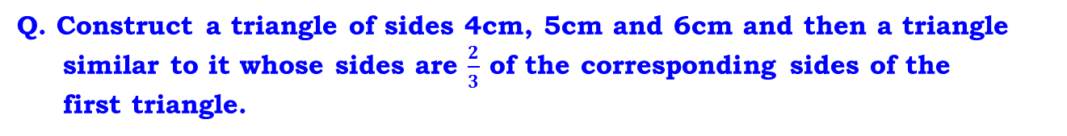
Ex-13.1 (Q.2)
Q. Construct a triangle of sides 4cm, 5cm and 6cm and then a triangle
similar to it whose sides are $\frac{2}{3}$ of the corresponding sides of the
first triangle.
A
C as centre, and any suitable radius, draw an arc intersecting BC and AC at points T & U respectively
Rough Figure
B₃ as centre and any suitable radius, draw an arc intersecting BX and B₃C at points P & Q respectively
Now, consider radius = PQ
C' as centre and with the same radius, draw an arc intersecting BC at point V
B₂ as centre and with the same radius, draw an arc intersecting BX at point R
Now, consider radius = TU
Considering any suitable radius, draw 3 arcs on ray BX
C as centre and r = 4cm,
cut the previous arc
mark point A
C as the centre and same radius, draw another arc
Any point on the line as centre and radius = 6 cm, draw an arc
Draw B₂S intersecting BC at C'
A
B as centre, r = 5cm,
draw an arc
R as centre, cut an arc and mark that point S
A′B
BC′
A′C′
2
Draw C'W intersecting AB at A'
V as centre, cut an arc and mark that point W
Draw ray BX
Draw AB and AC
Draw B₃C
=
=
=
A'
Draw seg BC = 6cm
AB
BC
AC
3
4 cm
5 cm
A′
W
5 cm
4 cm
U
1
2
3
4
5
6
7
8
9
10
11
12
13
14
15
1
2
3
4
5
6
7
8
9
10
11
12
13
14
15
6 cm
C′
B
V
T
C
1
2
3
4
5
6
7
8
9
10
11
12
13
14
15
B
C′
C
1
2
3
4
5
6
7
8
9
10
11
12
13
14
15
B₁
S
6 cm
R
B₂
Q
1
2
3
P
1
2
3
4
5
6
4
7
5
8
6
9
7
8
9
10
11
12
13
14
15
10
11
12
13
14
15
1
2
3
7
B₃
9
4
5
6
8
10
11
12
13
14
15
1
2
3
4
5
6
7
8
9
10
11
12
13
14
15
1
2
3
X
9
4
5
6
7
8
10
11
12
13
14
15

Slide 12

Q. Construct a triangle of sides 4cm, 5cm and 6cm and then a triangle
similar to it whose sides are $\frac{2}{3}$ of the corresponding sides of the
first triangle.
A
Justification:-
A'
∴
A′C′ ║ AC
[By construction]
5 cm
4 cm
ΔA′BC′ ∼ ΔABC
[AA Similarity]
A′B
BC′
A′C′
[corresponding sides
of similar triangles]
=
=
AB
BC
AC
B
6 cm
C'
C
BC′
BB$2$
2
[since ΔBB₂C_{l} ∼ΔBB₃C]
But,
=
=
B₁
BC
BB₃
3
BC′
2
B₂
∴
=
BC
3
B₃
∴
A′B
BC′
A′C′
2
=
=
=
AB
BC
AC
3
X

Slide 13
Module 4

Slide 14
CONSTRUCTIONS
To construct triangle similar to a given triangle
Notes:
School
14

Slide 15
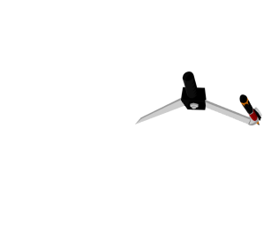
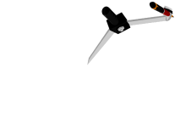


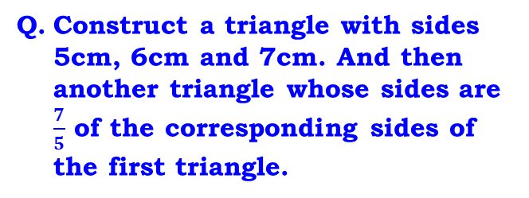
Ex-13.1 (Q.3)
1
A′
2
3
4
5
6
7
8
9
10
11
12
13
14
15
Rough Figure
A'
Q. Construct a triangle with sides
5cm, 6cm and 7cm. And then
another triangle whose sides are
$\frac{7}{5}$ of the corresponding sides of
the first triangle.
A
B₅ as centre and any suitable radius, draw an arc intersecting BX and B₅C at points P & Q respectively
A
C as centre and any suitable radius, draw an arc intersecting BC and AC at points T & U respectively
Any point on the line as centre and radius = 7 cm, draw an arc
Now, consider radius = PQ
C as the centre and same radius, draw another arc
Now consider radius = TU
C' as centre and with the same radius, draw an arc intersecting BC at point V
C as centre and r = 5cm,
cut the previous arc
mark point A
B₇ as centre and with the same radius, draw an arc intersecting BX at point R
Considering any suitable radius, draw 7 arcs on ray BX
Draw B₇S intersecting BC at C'
Draw C'W intersecting AB at A'
Draw ray BX
B as centre, r = 6cm,
draw an arc
6 cm
Draw seg BC = 7cm
R as centre, cut an arc and mark that point S
Draw B₅C
V as centre, cut an arc and mark that point W
5 cm
Draw AB and AC
6 cm
5 cm
1
2
3
4
5
6
7
8
9
10
11
12
13
14
15
B
7 cm
C
C′
U
W
A′B
BC′
A′C′
7
=
=
=
AB
BC
AC
5
1
2
3
4
1
5
2
6
3
7
4
8
5
9
6
7
8
9
10
11
12
13
14
15
7 cm
10
11
12
13
14
15
B
2
T
C
V
C'
1
3
4
5
6
7
8
9
10
11
12
13
14
15
B₁
B₂
B₃
Q
1
2
3
4
1
5
2
6
3
7
8
9
7
8
9
4
5
6
10
11
12
13
14
15
P
10
11
12
13
14
15
B₄
B₅
S
1
2
3
4
5
6
7
8
R
9
10
11
12
13
14
15
B₆
1
1
2
2
3
3
4
5
6
7
7
8
8
9
9
10
11
12
13
14
15
4
5
6
10
11
12
13
14
15
B₇
X

Slide 16

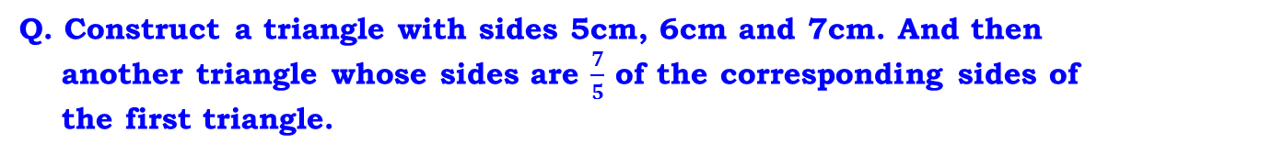
Q. Construct a triangle with sides 5cm, 6cm and 7cm. And then
another triangle whose sides are $\frac{7}{5}$ of the corresponding sides of
the first triangle.
A'
Justification :
A
∴
A′C′ ║ AC
[by construction]
6 cm
5 cm
ΔA′BC′ ∼ ΔABC
[AA Similarity]
B
7 cm
C
C'
A′B
BC′
A′C′
[corresponding sides of
similar triangles]
B₁
=
=
AB
BC
AC
B₂
B₃
BC′
BB$7$
7
B₄
But,
=
=
[since ΔBB₅C ∼ΔBB₇C_{l}]
B₅
BC
BB₅
5
B₆
BC′
7
B₇
∴
=
X
BC
5
∴
A′B
BC′
A′C′
7
=
=
=
AB
BC
AC
5

Slide 17
Module 5

Slide 18
CONSTRUCTIONS
To construct triangle similar to a given triangle
Notes:
School
18

Slide 19





Ex-13.1 (Q.4)
A'
Rough Figure
Q. Construct an isosceles triangle
whose base is 8cm and altitude
4cm and then another triangle
whose sides are 1 $\frac{1}{2}$ times the
corresponding sides of isosceles
triangle.
P
C as centre and any suitable radius, draw an arc intersecting BC and AC at points T & U respectively
A
B₂ as centre and any suitable radius, draw an arc intersecting BD and B₂C at points J & K respectively
C' as centre and with the same radius, drawn an arc intersecting BC at point V
Now, consider radius = JK
C as centre and with the same radius cut the previously drawn arcs
Considering any suitable radius, draw 3 arcs on ray BD
B₃ as centre and with the same radius, draw an arc intersecting BD at point R
B as centre radius more than half of BC, draw acrs up and down
M as centre radius = 4cm,
draw an arc
Let us draw perpendicular bisector of BC
Draw line PQ
Draw B₃S intersecting BC at C'
Draw ray BD
A
R as centre, cut an arc and mark that point S
Draw AB and AC
Draw B₂C
Draw seg BC = 8cm
1
2
3
4
5
6
7
8
9
10
11
12
13
14
15
4 cm
B
C
4 cm
8 cm
1
2
3
4
5
6
7
8
9
10
A′B
BC′
A′C′
3
11
12
13
14
15
1
2
3
4
5
6
7
8
9
10
11
12
13
14
U
15
W
=
=
=
AB
BC
AC
2
M
B
8 cm
T
C
V
C'
1
1
2
2
3
3
4
5
6
7
7
8
9
10
11
12
13
14
15
4
5
6
8
9
10
11
12
13
14
15
1
2
3
4
5
6
7
8
9
10
11
12
13
14
15
B₁
1
2
3
1
2
3
7
9
7
8
9
8
4
5
6
4
5
6
10
11
12
13
14
15
J
10
11
12
13
14
15
K
B₂
R
S
1
2
3
7
B₃
9
4
5
6
8
10
11
12
13
14
15
1
2
3
4
5
Q
7
8
9
6
10
11
12
13
14
15
1
2
3
7
D
9
4
5
6
8
10
11
12
13
14
15

Slide 20

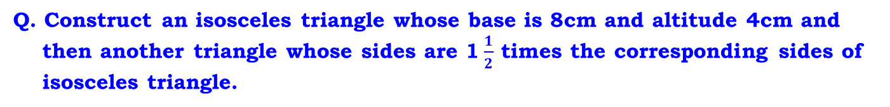
Q. Construct an isosceles triangle whose base is 8cm and altitude 4cm and
then another triangle whose sides are 1 $\frac{1}{2}$ times the corresponding sides of
isosceles triangle.
Justification :
A'
∴
A′C′ ║ AC
[By construction]
P
ΔA′BC′ ∼ ΔABC
[AA Similarity]
A
A′B
BC′
A′C′
[corresponding sides of
similar triangles]
4 cm
=
=
AB
BC
AC
BC′
BB$3$
3
M
C
=
B
8 cm
C'
But,
=
[since ΔBB₂C ∼ΔBB₃C^{l}]
BC
BB₂
2
B₁
∴
BC′
3
=
B₂
BC
2
B₃
A′B
BC′
A′C′
3
Q
∴
=
=
=
D
AB
BC
AC
2

Slide 21
Module 6

Slide 22
CONSTRUCTIONS
To construct triangle similar to a given triangle
Notes:
School
22

Slide 23
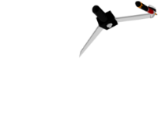

Ex-13.1 (Q.5)
Q. Draw a ΔABC with BC = 6cm,
AB = 5cm and ∠ABC = 60º. Then
construct a triangle whose sides
are $\frac{3}{4}$ of the corresponding sides
of ΔABC.
C as centre and any suitable radius, draw an arc intersecting BC and AC at points T & U respectively
K as centre and with the same radius, cut the previously drawn arc at point L
B as centre and radius = 5cm,
draw an arc intersecting ray BL at point A
B₄ as centre and any suitable radius, draw an arc intersecting BX and B₄C at points P & Q respectively
Now, consider radius = TU
B₃ as centre and with the same radius, draw an arc intersecting BX at point R
Now, consider radius = PQ
C' as centre and with the same radius, draw an arc intersecting BC at point V
Considering any suitable radius, draw 4 arcs on ray BX
C as the centre and same radius, draw another arc
B as centre and any suitable radius, draw an arc intersecting BC at point K
A
Any point on the line as centre and radius = 6 cm, draw an arc
Draw C'W intersecting AC at A'
Draw B₃S intersecting BC at C'
Draw ray BX
Draw B₄C
V as centre, cut an arc and mark that point W
Draw seg BC = 6cm
Draw AC
Draw BL
R as centre, cut an arc and mark that point S
A'
5 cm
A′B
BC′
A′C′
3
A
=
=
=
AB
BC
AC
4
L
A′
Rough Figure
1
2
3
4
5
6
7
8
9
10
11
12
13
14
15
5 cm
W
U
1
2
1
2
3
7
8
9
3
4
7
8
9
4
5
6
5
6
10
11
10
11
12
13
14
15
12
13
14
15
60º
B
K
6 cm
V
C'
T
C
60º
1
2
3
4
5
6
7
8
9
10
11
12
13
14
15
C
B
C′
B₁
6 cm
S
B₂
R
1
2
3
2
7
8
9
Q
1
4
3
7
9
5
6
8
2
4
5
6
10
11
12
13
14
15
1
3
7
B₃
9
10
11
12
13
14
15
4
5
6
8
P
10
11
12
13
14
15
B₄
X
1
2
3
4
5
6
7
8
9
10
11
12
13
14
15
1
2
3
4
5
6
7
8
9
10
11
12
13
14
15

Slide 24

Q. Draw a ΔABC with BC = 6cm, AB = 5cm and ∠ABC = 60º. Then
construct a triangle whose sides are $\frac{3}{4}$ of the corresponding sides of ΔABC.
Justification :
A
A'
∴
A′C′ ║ AC
[By construction]
5 cm
ΔA′BC′ ∼ ΔABC
[AA Similarity]
A′B
BC′
A′C′
[Corresponding sides of
similar triangles]
=
=
AB
BC
AC
B
6 cm
C'
C
BC′
BB$3$
3
B₁
But,
=
=
[since ΔBB₃C^{l} ∼ ΔBB₄C]
BC
BB₂
4
B₂
∴
BC′
3
=
B₃
BC
4
A′B
BC′
A′C′
3
B₄
∴
=
=
=
AB
BC
AC
4
X

Slide 25
Thank You

